Slide 1
Mind Management Skills Workshops
Adjusting to University Life

Slide 2
Introduction to our series of workshops
Our clinic – Psychological Therapies Training and Research Clinic
Our roles: Cognitive Behavioural Therapists and Clinical Psychologists
The purpose of these workshops – to reach a greater number of students experiencing common problems and stressors
To learn ways of overcoming these problems and improving wellbeing in doing so
Not “mental health problem” centred
Not “group therapy” programmes
Invitation to learn new skills and meet new people

Slide 3
Housekeeping
Today’s workshop will run for 90 minutes and is designed to be interactive – we encourage participation
Confidentiality – you are not expected to share anything that you do not want to, however we do request that anything that is shared remains confidential and is not shared with any one else outside of the group
Please be respectful of other group members who may choose to share their experiences – maintain the confidentiality of the group

Slide 4
Further Support
The workshops are designed to be skills-focussed, rather than problem-centred. However, if any of today’s discussion or exercises cause you to experience distress, you may wish to pursue further support
Full details can be found in the supporting information you received before this workshop
Accessing the Student Health and Wellbeing Service
Listening services such as the Nightline and the Samaritans
How to access evidence-based therapy through the NHS

Slide 5
Questionnaire

Slide 6
Goals for today
Explore some of the challenges of adjusting to life at University
Learn about the CBT model and vicious cycles
Increase awareness of unhelpful patterns and traps that make it harder to adjust to University life
Consider how we can break out of unhelpful patterns
Think about behavioural strategies than help to manage our stress
Notes:
Say about a integeral part of cbt is homework

Slide 7
Why “Adjusting to University Life”?
We ran a series of focus groups with undergraduate students to find out what they experienced as common difficulties in student life
The tasks involved in adjusting to University life were reported as some of the most common problems students struggled with
We want to provide workshops to help UG students learn ways of adjusting effectively to the challenges of University life

Slide 8
What is CBT?
An evidence-based talking therapy
A way of understanding the relationship between our thoughts, emotions, physiology and behaviour
A therapy that provides a range of coping strategies or techniques that can influence these patterns
Some of which we will be discussing later in this workshop

Slide 9
Life Changes and adjustments
Beginning University for the first time as an undergraduate student is a major life event
UG students have to adjust to multiple changes in their day to day routines

Slide 10
Life Changes and adjustments
Social changes
Reduced contact with family in daily life
Learning to live alongside housemates
Reduced contact with friends from college or school
Geographic changes
Living in a new room, flat or house for the first time
Getting to know the broader Campus
Learning the local area, new City Centre
Occupational changes
Adjusting to fully independent study
Accountability for lecture attendance
Managing workload and assignments independently
Leisure changes
Not having the same sports, hobbies, teams
More opportunities to join societies and experience new activities
Routine changes
Managing self-care – learning new skills
Different timetable
Domestic tasks
Financial changes
Living on a budget
Managing money
Part-time work

Slide 11
Life Changes and adjustments
Adjusting to UG life involves letting go of old behaviours/routines and creating new ones
Attending school -> going to lectures/independent study
Seeing schoolfriends -> getting to know house and course-mates
Leaving previous clubs -> joining new societies
Successfully adjusting requires both letting go of the old way of doing things and embracing new ways

Slide 12
Life Changes and adjustments
Adjusting can be difficult
Getting used to new routines and ways of doing things can be very stressful
It can be tempting to fall into “solutions” that offer short-term relief to this discomfort, but don’t help us to adjust in the long-term
The CBT model explains this clearly

Slide 13
Vicious Cycles in CBT
Trigger
Thoughts
Behaviour
Emotions
Physical

Slide 14
Vicious Cycles in CBT
Trigger – attending a revision lecture before the exam and realising I haven’t been keeping up with the reading and workload for the module
Thoughts – “I’m going to fail this! I’ve got so much reading to do…”
Behaviour – procrastinate, distract myself with Netflix
Emotions – feel anxious, panicked
Physical – tense, hot, restless

Slide 15
Vicious Cycles in CBT
Trigger – falling out with a flatmate
Thoughts – “they’re judging me, no one wants me to live in this flat with them”
Behaviour – withdraw, shut myself in my bedroom, avoid the rest of the flat
Emotions – feel low, miserable
Physical – heavy, lethargic

Slide 16
Exercise – the vicious cycle
Use handout 1
Either individually or if comfortable, in pairs or threes
Bring to mind an example of a time you struggled with adjusting to an aspect of University life
Choose an example that is not too distressing and that you are comfortable reflecting on in this group
Complete the handout:
What situation were you in?
What went through your mind?
How did you feel?
What did you do?
How do these things connect?

Slide 17
How behaviours are reinforced
A behaviour is more likely to be repeated if we experience reinforcement after doing it
A behaviour is less likely to be repeated if we experience something unpleasant or undesirable after doing it (punishment)
There are two ways a behaviour can be reinforced
Positive reinforcement
Negative reinforcement

Slide 18
Positive reinforcement
When a behaviour causes something pleasant or desirable to occur as a consequence of it
Something good occurring after an action increases the chance of it being repeated in the future
Behaviour
Went to the union with Alex and had a chat and a few pints
Consequence
Had a laugh, we both had fun and enjoyed ourselves
Behaviour of going to the union with Alex is more likely to be repeated again in the future

Slide 19
Negative reinforcement
When a behaviour causes something unpleasant or undesirable to reduce as a consequence of it
Something bad reducing after an action increases the chance of the action being repeated in the future
Behaviour
Putting off starting my assignment by playing videogames
Consequence
For a while I stopped feeling stressed out when I was doing something else
Behaviour of putting off the assignment likely to be repeated again in the future

Slide 20
Negative reinforcement
Trigger – attending a revision lecture before the exam and realising I haven’t been keeping up with the reading and workload for the module
Thoughts – “I’m going to fail this! I’ve got so much reading to do…”
Behaviour – procrastinate, distract myself with Netflix
Emotions – feel anxious, panicked
Physical – tense, hot, restless

Slide 21
Negative reinforcement
Trigger – attending a revision lecture before the exam and realising I haven’t been keeping up with the reading and workload for the module
Thoughts – “I’m going to fail this! I’ve got so much reading to do…”
Behaviour – procrastinate, distract myself with Netflix
Emotions – feel anxious, panicked
Physical – tense, hot, restless

Slide 22
Negative reinforcement
Behaviour such as avoidance, distraction and procrastination can be very effective in the short-term…
Trigger – feeling anxious after realising the work I haven’t done for the exam
Behaviour
Procrastinate – distract myself with Netflix
Consequences
Relief from feeling anxious – happily distracted with a boxset
Psychological Therapies Training and Research Clinic; School of Psychology

Slide 23
The trap
…but often produces unwanted or unintended consequences later on
This is what can make adjusting difficult, as behaviour that causes short-term relief from feeling bad is not the same as behaviour that causes us to feel good in the long run
Trigger – feeling anxious after realising the work I haven’t done for the exam
Behaviour
Procrastinate – distract myself with Netflix
Consequences
Relief from feeling anxious – happily distracted with a boxset
Long-term consequences
Less time to revise now, more anxious that if I started earlier
Psychological Therapies Training and Research Clinic; School of Psychology

Slide 24
Alternative coping
Having reflected on specific behaviours that can make adjusting more difficult, we want to consider alternative actions
Behaviour that will be more difficult in the short-term but produce much more desirable consequences in the long run
Short-term cost for long-term benefit
Trigger – feeling anxious after realising the work I haven’t done for the exam
Behaviour
Work out where to begin and start reading for a couple of hours
Consequences
Initial rise in anxiety when I started working, effort of reading difficult material
Long-term consequences
Stress reduced as I got into it, sense of accomplishment at what I got done, less intimidated to do the rest now
Psychological Therapies Training and Research Clinic; School of Psychology

Slide 25
Trap vs Alternative Coping
Behaviour
Procrastinate – distract myself with Netflix
Consequences
Relief from feeling anxious – happily distracted with a boxset
Long-term consequences
Less time to revise now, more anxious that if I started earlier
Trigger – feeling anxious after realising the work I haven’t done for the exam
Behaviour
Work out where to begin and start reading for a couple of hours
Consequences
Initial rise in anxiety when I started working, effort of reading difficult material
Long-term consequences
Stress reduced as I got into it, sense of accomplishment at what I got done, less intimidated to do the rest now
Psychological Therapies Training and Research Clinic; School of Psychology

Slide 26
Trap vs Alternative Coping
Trigger – attending a revision lecture before the exam and realising I haven’t been keeping up with the reading and workload for the module
Thoughts – “I’m going to fail this! I’ve got so much reading to do…”
Behaviour – procrastinate, distract myself with Netflix
Emotions – feel anxious, panicked
Behaviour
Work out where to begin and start reading for a couple of hours
Physical – tense, hot, restless

Slide 27
Exercise
Use handout 2
Either individually or if comfortable, in pairs or threes
Using your example from handout 1, work through handout 2
What was your behaviour in response to the situation?
And what were it’s short and long-term consequences?
What alternative coping behaviours can you think of that could help in this situation?
Any what consequence could they lead to?

Slide 28
Trap vs Alternative Coping
The typical pattern: behaviour that forms a trap is easier in the short-term (relief) but harder in the long run, alternative coping is harder in the short-term (effort) but better in the long run
There isn’t an easy or magic solution to this predicament – behaviour that is helpful is often harder to do than behaviour that comes easily
Psychological Therapies Training and Research Clinic; School of Psychology

Slide 29
Tips for alternative coping
Plan a behaviour that is specific
What will I do? When? Where? Who with? How long for? What will I need in order to do it?
Imagine/visualise the behaviour beforehand – rehearsal
Be realistic – grading the behaviour
Flash forward – imagine the outcome once it has been done vs the consequences of not doing it
Ultimately, act against your inclination
Psychological Therapies Training and Research Clinic; School of Psychology

Slide 30
The Stress Bucket
Psychological Therapies Training and Research Clinic; School of Psychology

Slide 31
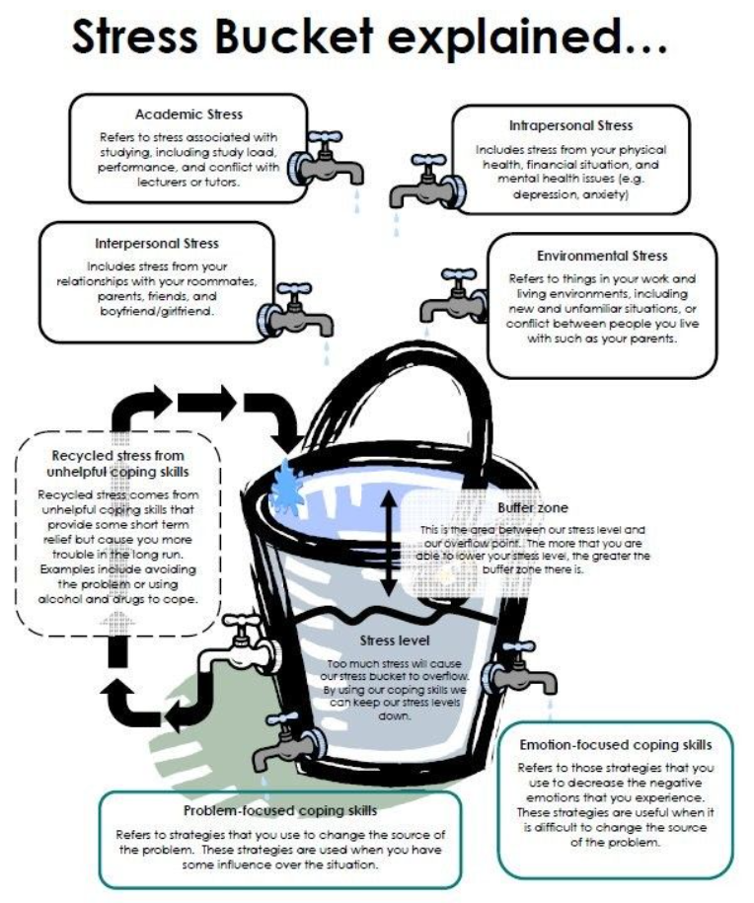
Key Messages
Taken from https://www.pinterest.co.uk/pin/542754192595039435

Slide 32
Problem-focussed coping
Relieving stress through addressing the problem
Approaching the issue that needs to be solved
Accessing resources
Influencing what can be changed
What strategies help you problem solve?
Psychological Therapies Training and Research Clinic; School of Psychology

Slide 33
Emotion-focussed coping
Behaviour that reduces stress
Helpful when sources of stress can’t necessarily be changed
Ways of achieving relaxation
Part of self-care and good wellbeing
Individual – what helps a person relax from stress will be unique to them
What do you do that helps you reduce feelings of stress?
Psychological Therapies Training and Research Clinic; School of Psychology

Slide 34
Exercise
Use handout 3
Either individually or if comfortable, in pairs or threes
Work through the stress bucket
Identify your common sources of stress
Work out what your taps are
Problem-focussed
Emotion-focussed
What can you do to lower the water level?

Slide 35
Key messages
Adjusting to University life is challenging
Successfully adjusting means letting go of old routines and investing in new ways of doing things
Traps occur when we do things that give short-term relief but don’t help us in the long run
Alternative coping behaviours can be harder at first but worth it in the end
It is helpful to be mindful of your stress levels and what you need to do to look after yourself

Slide 36
Homework
Practice the skills from today’s workshop
Using your handouts, throughout the week use the blank vicious cycle diagrams to record your thoughts, feelings and behaviours when you notice you are struggling with an adjustment to University life
Identify what you are doing and what consequences it will lead to
Work out alternative coping behaviours
Plan specifically what to do differently
Think about your stress bucket and what you need to do to keep the water level low

Slide 37
Thank you

